Slide 1
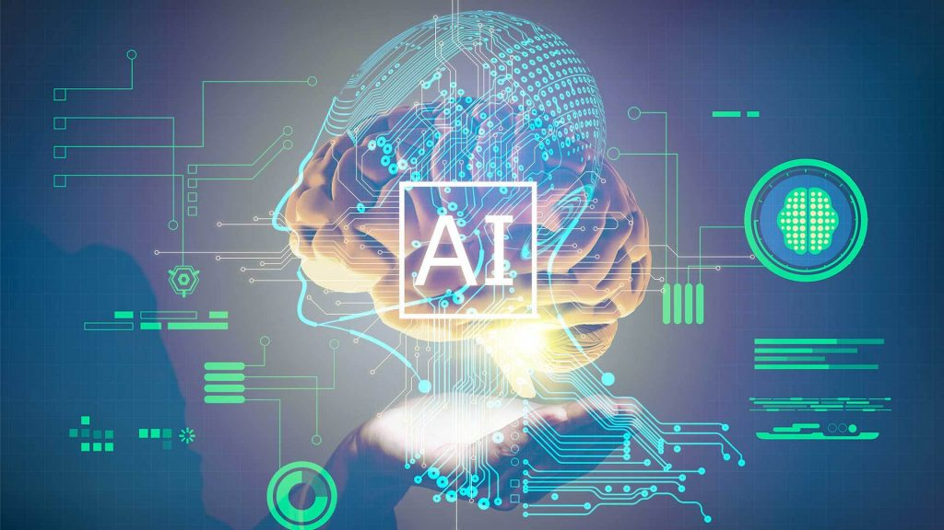
Developing powerful education tools
By Ashish Kumar and Ujjwal Kumar

Slide 2
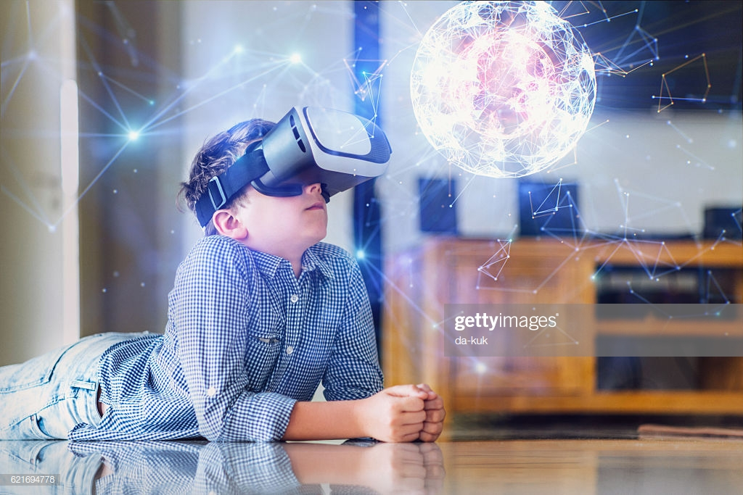

Slide 3
Traditional Means
This method was based on the principle of 3R-
1.Read
2.Recite
3.Recall
Does traditional education prepare students adequately for the future ?

Slide 4
Well it is not the case this this method was not successful in that era.It was quite successful in that era because in that era:
1.Ideas were very less.
2.more workers were needed as industrial revolution was evolving.
The traditional method of education was quite compatible.

Slide 5
Let's have a look how the classrooms looked like about 100 years ago. Shall we???

Slide 6
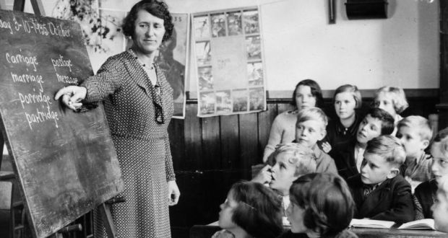

Slide 7
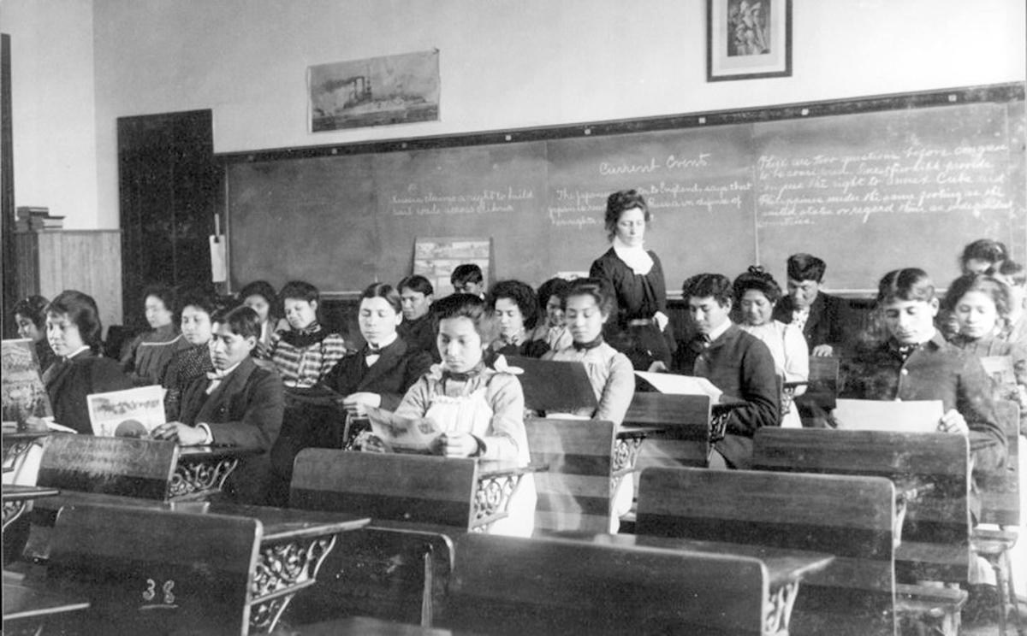

Slide 8
Now lets have a look in our modern education

Slide 9
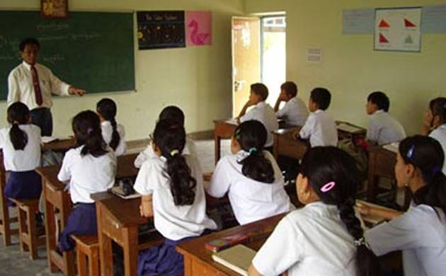

Slide 10
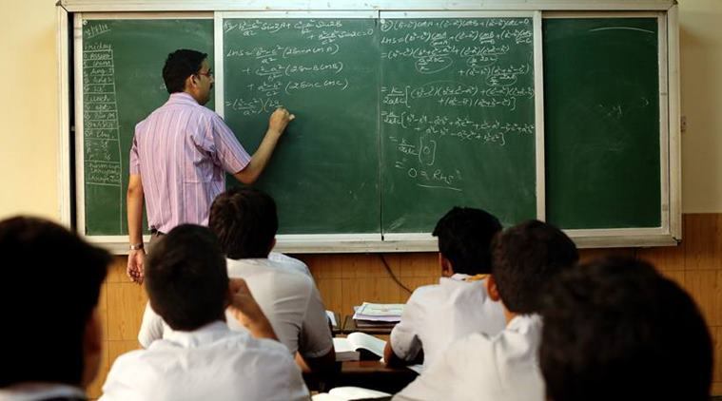

Slide 11
Well even after more than a century,the scenario of education has not changed much...
Notes:
Since we are changing in all aspects

Slide 12


Slide 13
Drawback of present Education System
Snail like progress
Overburden
Doesn’t focus on originality
Less scope for creativity
Notes:
A ‘good show’ by a student in his paper may fetch him good marks in the examination. But that does not establish the student’s original or genuine quality or ability.

Slide 14

Future of Education System

Slide 15
Introducing AI in VR
The concept of virtual reality itself is of great significance in upgrading the education system.When synced with the advance concept such AI,our educational system will be so powerful that it will transcend all the known barriers that we are facing now.

Slide 16
Advantages of AVR
Nowadays we are all are familiar with the concept of Artificial Intelligence and Machine Learning.These are already being implemented to enrich our experiences mostly in entertainment field.Eg-We often get recommendations for the shopping websites,movies to watch and others stuffs like that.
It goes without saying that if we implement these concepts in the education field,it will prove quite effective.

Slide 17
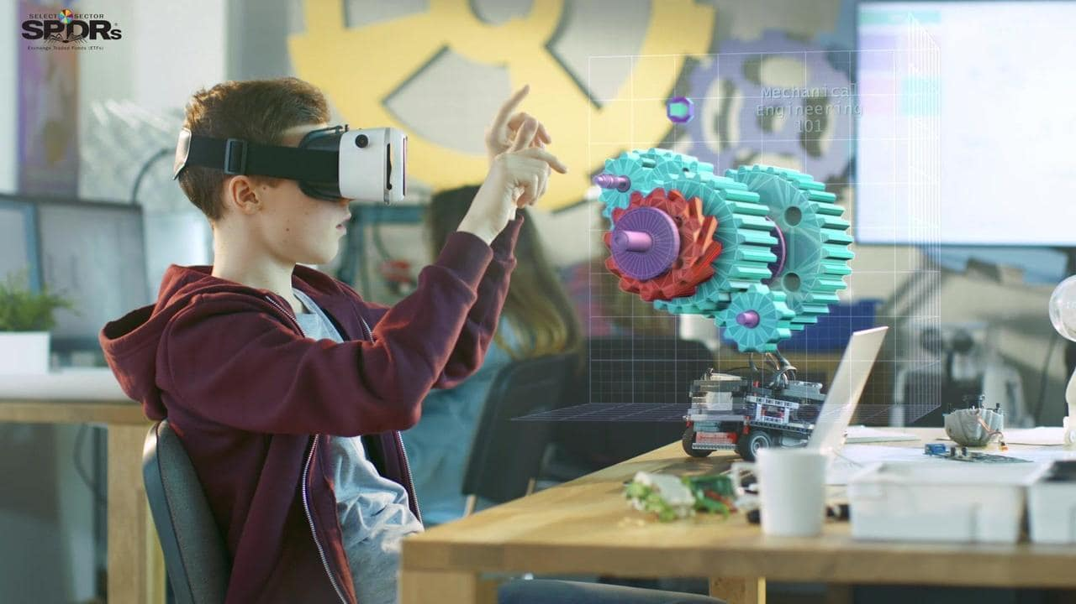

Slide 18
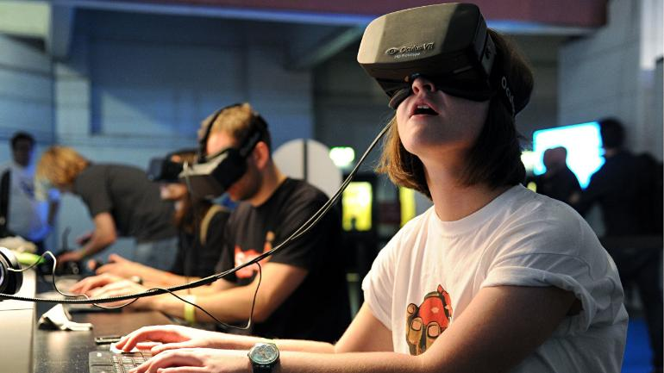

Slide 19
In 2011, Google launched the online course “Introduction into AI” in which 160,000 students enrolled in the first batch
So from these data we get that :-
Student are tired of the current education system.
They want new type of education , which understand
them and suggest proper field for their skills.
click here for more info

Slide 20
ADULT
EDUCATION

Slide 21
In the developing countries such as India,adult illiteracy is still
a major problem.Despite many NGOs and campaign,this problem still persists due to many reasons.One of the reason is that adults don’t have the same learning skill as a child has.Also they may have some emotional issues which can’t be comprehended by a human mind.This problem can be tackled with the help of AI as it will be synced throughly with their minds and thoughts.Thus AVR will be a major breakthrough in removing the problem of ADULT ILLITERACY.

Slide 22
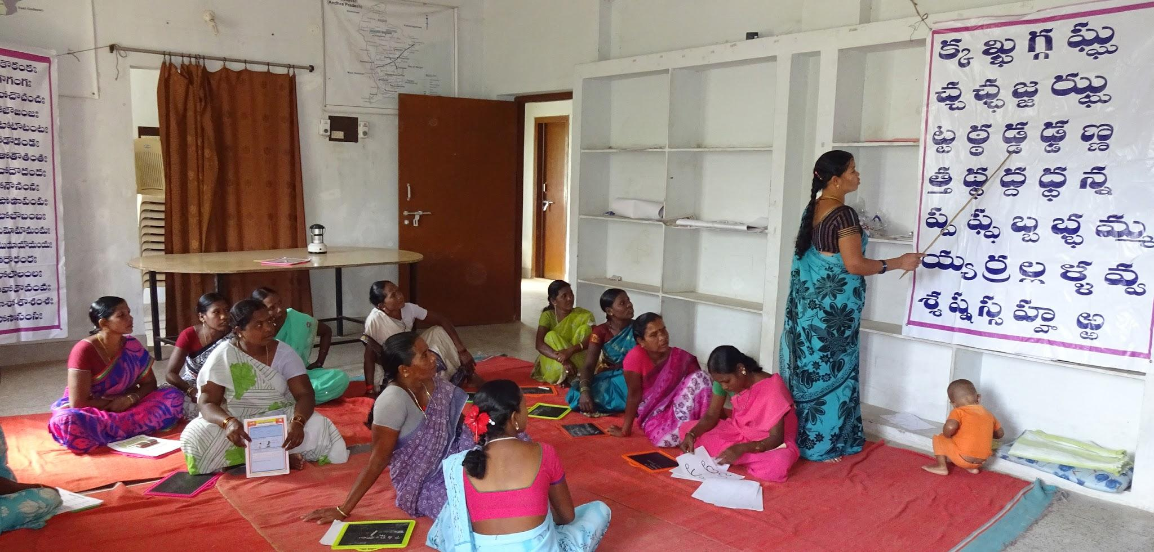

Slide 23
Artificial intelligence in Education System
We think…..
AI will monitor the learning habits and mindset of particular individuals based on their interaction and participation in the course and track their progress throughout.It will be more efficient than what any human being can achieve with his or her students.
The outcomes may be...
Individual based curricullum and teaching methods.
Suggest exercises that are based on the interests ,Skill level of every student.

Slide 24
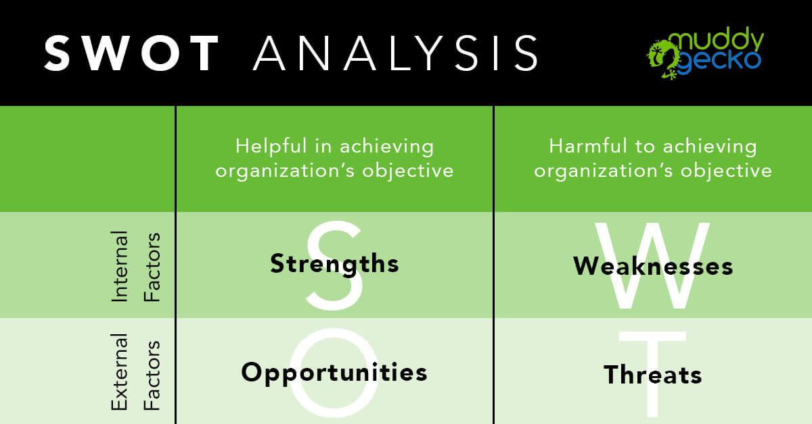

Slide 25

1
1>

Slide 26
1.AVR will dominate all the competitors in the market.
2.Transforms the humans into more mature and knowledgeable beings each being aware of their potential.
3.Unlocks the potential of the individuals,
4.Overall development of humanity and it will happen by the contribution of each individual.
5.Changes of meaning of education.
6.Decrease the education pressure on students.
7.Increases the interest among the students

Slide 27


Slide 28
1.Investment might be costly.
2.People may have difficulty adjusting to this idea.
3. AI can stimulate technology addiction.
4.The attention and the ability to multitask reduces.
5.Deteriorates Human Connections
6.Functionality Issues.

Slide 29


Slide 30
1.AI and VR are still in their developing stages but already creating a huge impact.So there will be a huge demand of them in market.
2.Education sector already covers a major fraction of every’s countries GDP.So AVR will dominate the market when implemented in education sector.
3.New sophisticated jobs opportunities available.

Slide 31


Slide 32
1.It may cause health related problems among individuals.
2.Job redundancy in traditional sectors.
3.Persons may feel overwhelmed due to Virtual Reality.

Slide 33

Conclusion
Educational institutions have to find new approaches to prepare students sufficiently for their future, by introucing VR . To achieve that, teachers and digital systems such AI engines will have to learn to collaborate effectively to overcome the remaining challenges on the path towards better education. Therefore, it is crucial that AI systems are tailored to act side-by-side with teachers, taking on the repetitive tasks and leaving the challenging ones to the human. This will allow educational institutions to increase productivity, save cost, and create new opportunities

